Slide 1

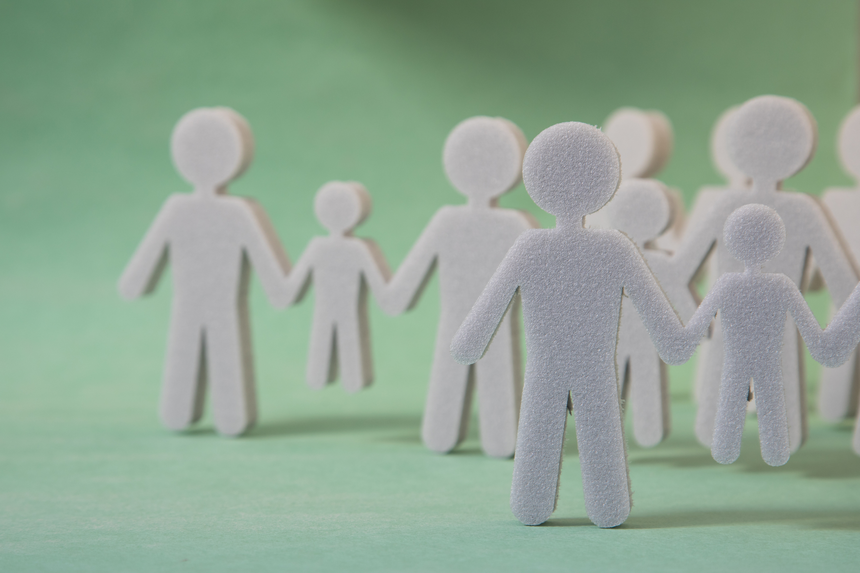
NAACP Team Presentation
Daniel Dash, Melissa Ellin,Lily Kepner, Temi Lajumoke, Hong Xin, Miranda Xu

Slide 2

After First Meeting with Advisors

Slide 3
Colab with Prof. Gianluca Stringhini
Goals:
Generate word embeddings using Boston Globe articles from 2014-2018, using Word2Vec and Doc2Vec
Find the top words used in the most similar contexts as those in a list of provided keywords
Analyze any potentially interesting trends

Slide 4
Colab with Prof. Gianluca Stringhini
Progress:
We generated the top five words used in similar contexts to the given keywords.
We analyzed the results for any potentially interesting findings.
We also trained Word2Vec on bigrams (as opposed to single words) using the Gensim Phrases package.
Finally, we plotted word clouds for both types of analyses.

Slide 5
Colab with Prof. Gianluca Stringhini
Result:
We noticed some interesting findings in the unigram analysis using Word2Vec: some negative words such as ‘unaccountable’, ‘bullying’, ‘disputing’, ‘deray’, ‘devolved’, etc. were computed to be among the most similar to ‘black’ and black ethnic groups.
The bigram analysis using Word2Vec computed other races and ethnicities to be the most similar to ‘black’ and black ethnic groups.
The Doc2Vec analysis did not result in particularly interesting findings, likely because Word2Vec works on a more granular level.
We plotted word clouds too, but those were not very readable (example on next slide).

Slide 6
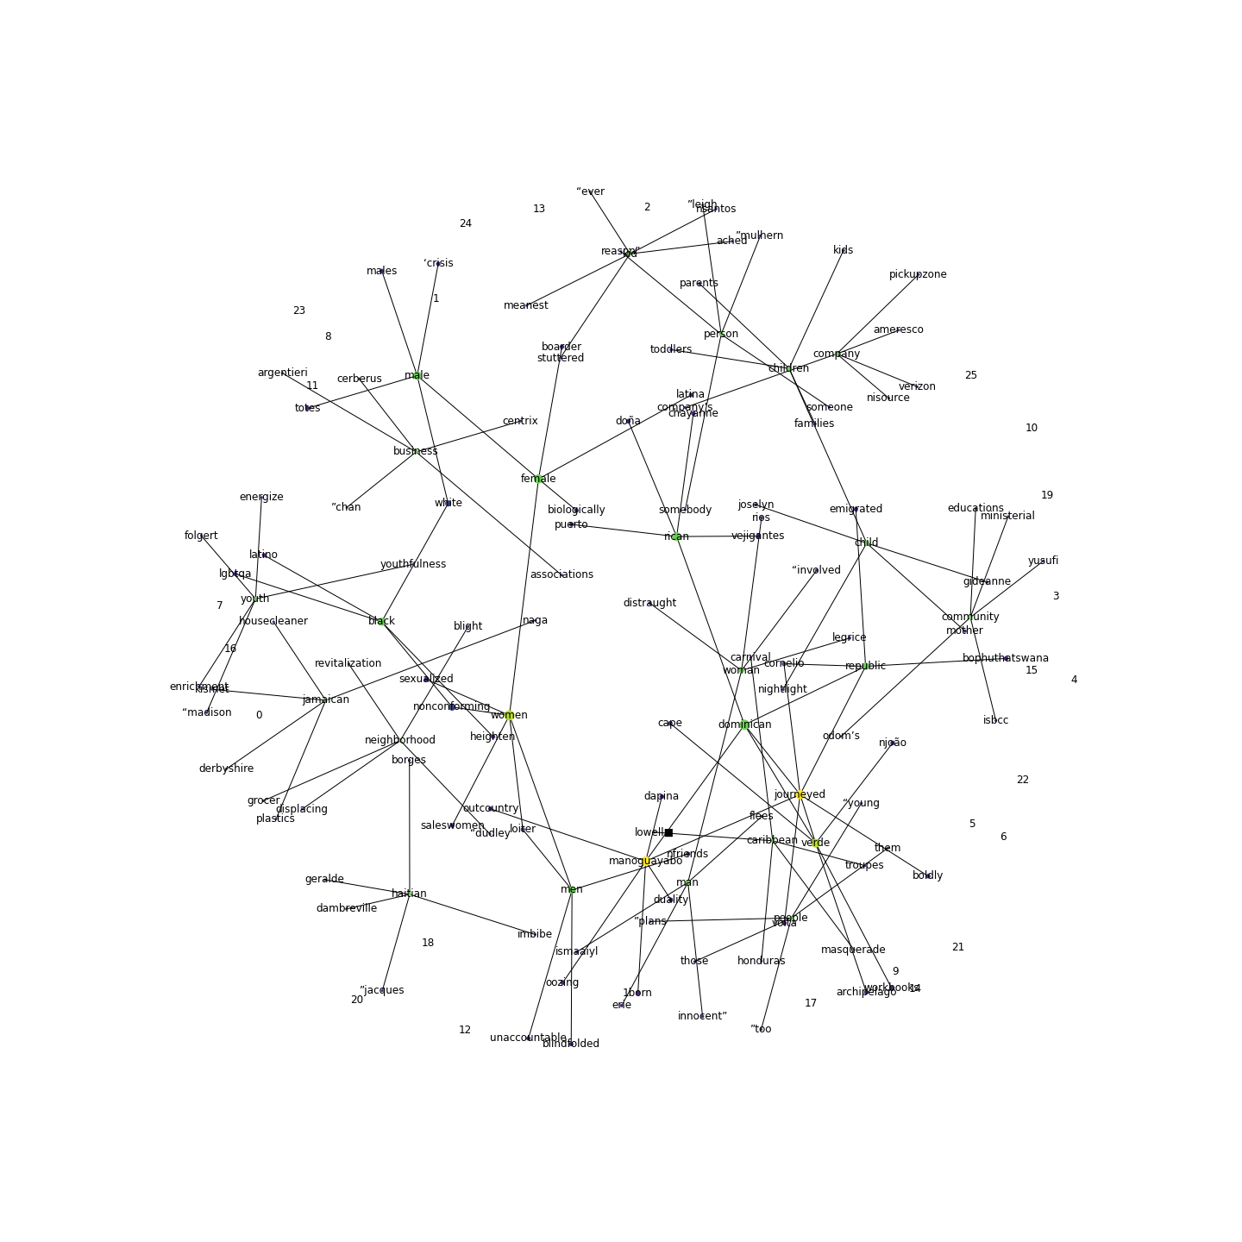

Slide 7
Colab with Prof. Derry Wijaya
Goal:
Use spaCy to process Boston Globe articles from 2014 – 2018 and perform named entity recognition (NER) on the processed ‘documents’
Identify all the entities labelled ‘PERSON’ or ‘ORG’
Use ethnicolr to predict the races of all identified people, using their last names, from U.S. Census data

Slide 8
Colab with Prof. Derry Wijaya
Progress:
We were able to use spaCy with its medium English language model (one of several language models available for use with spaCy) to process the articles.
spaCy’s included pipelines performed named entity recognition on the data, and we were able to simply extract all the entities labelled as people or organizations.
Finally, we were able to extract the last names of entities identified as people, and feed those ethnicolr to predict their races.

Slide 9
Colab with Prof. Derry Wijaya
Results:
We obtained three different datasets for each year:
A dataset of all entities labelled as people or organizations
A dataset of the names of all people mentioned in the articles
A dataset of the last names of all identified people and their predicted races

Slide 10
After Second Meeting with Advisors

Slide 11
Colab with Prof. Gianluca Stringhini
Goals:
Repeat last week’s process, but with black-majority and white-majority neighborhood names as keywords, instead of the ones provided earlier
For each set of similar words for a given keyword, use the generated word embeddings to compute a ‘mean’ representative word which captures the meaning, to some extent, of the corresponding similar words
Keep track of keyword frequency
Analyze any potentially interesting trends

Slide 12
Colab with Prof. Gianluca Stringhini
Progress:
We generated the top five words used in similar contexts to the given neighborhoods; however, this resulted in other neighborhood names being computed as the most similar, so we filtered those out.
We used the word embeddings and the neighborhood-filtered similar words to compute an average representative word for each neighborhood.
We analyzed the results for any potentially interesting findings.
Finally, we plotted word clouds for both types of analyses.

Slide 13
Colab with Prof. Gianluca Stringhini
Results:
This time, the most similar words do not seem to be of much interest.
The representative vectors for each neighborhood ended up being either the same neighborhood or another neighborhood (seems intuitive).
However, it was interesting to note that the black-majority neighborhoods were mostly represented by other black-majority neighborhoods, and white-majority ones by other white-majority ones.
This points toward some difference; whether this difference is in addition to cultural and political differences between the two communities is yet to be analyzed.

Slide 14
Colab with Prof. Derry Wijaya
Goals:
Analyze Boston Globe 2014 – 2018 articles and figure out which articles refer to which neighborhoods
Compute the distribution of black-majority and white-majority neighborhoods in terms of media coverage

Slide 15
Colab with Prof. Derry Wijaya
Progress:
We went through each of the articles and tracked occurrences of neighborhood names from our keywords from word embeddings.
Separately, we tracked the number of times a neighborhood name occurred in each of the articles, and tagged the article as discussing the neighborhood that occurred most frequently.

Slide 16
Colab with Prof. Derry Wijaya
Results:
Black-majority neighborhoods were found to be a lot more highly covered in the media, compared to white-majority neighborhoods.
We now have a dataset for each year, containing each of the articles for each of the given neighborhoods for that year.

Slide 17
Quote extraction and attribution
Goal:
Identify and extract all quotes in the text corpora: articles from boston globe
Deterministically extract the respective authors of each quote and attribute the quote to the author.
Generate a tabular structure of authors and their respective quotes

Slide 18
Quote extraction and attribution
Progress:
v1: Extracted quotes and generated respective quote tables for all quotes in articles in each year
v2: Improving upon v1 to determine the authors of all extracted quotes and add the authors to the table of quotes, grouped by the authors.

Slide 19

Journalism and UX

Slide 20
Journalism Goals for Summer
Complete Frame Analysis
Work with Brooke Williams and Michelle Johnson to develop a codebook for explicit and implicit mentions of race
Annotate LexisNexis articles for explicit mentions of race
Annotate for implicit mentions of race using the codebook
Interviews
- Develop script and sample questions
- Compile list of interview subjects
- Conduct interviews with editors and journalists to determine how they would like to use a product

Slide 21
What’s been done so far?
Drafted a script for interviews
Searched for tools like that of our end product
Received LexisNexis training
Scraped for Boston Globe articles
Practiced Frame Analysis readings using 140 articles spanning 2014-2020

Slide 22
Journalism Next Steps
Finalize interview script (meeting July 6)
Develop codebook with Brooke (July 6)
Finalize interview subject list and schedule interviews
Retrieve LexisNexis articles
Begin annotations
Continue frame analysis

Slide 23
UX Goal for the Summer
Finalize the User interview script
Conduct user interviews to found out users’ needs
Start working on the Lo-fi wireframes of the dashboard / website to track racial bias in the media and the real-time editors tool (similar to grammarly)

Slide 24
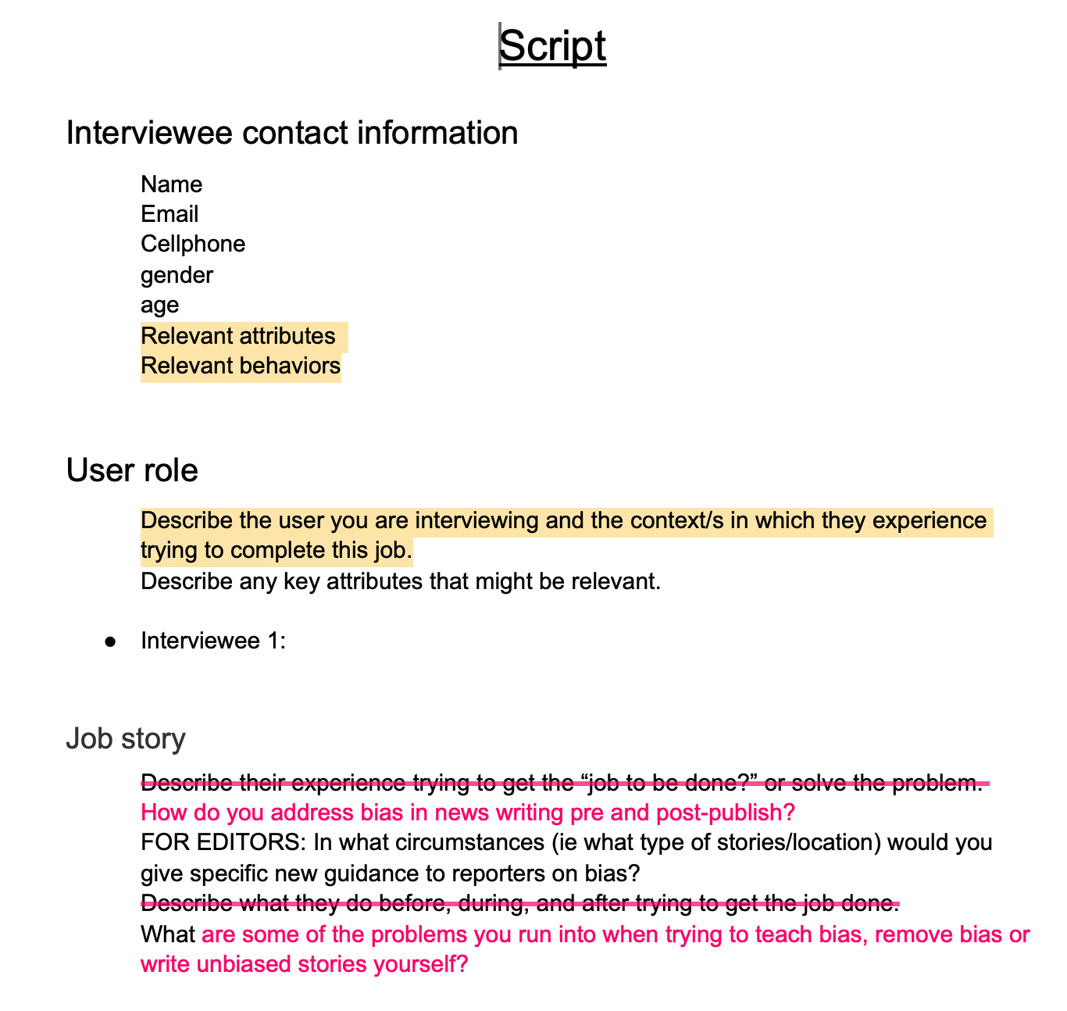
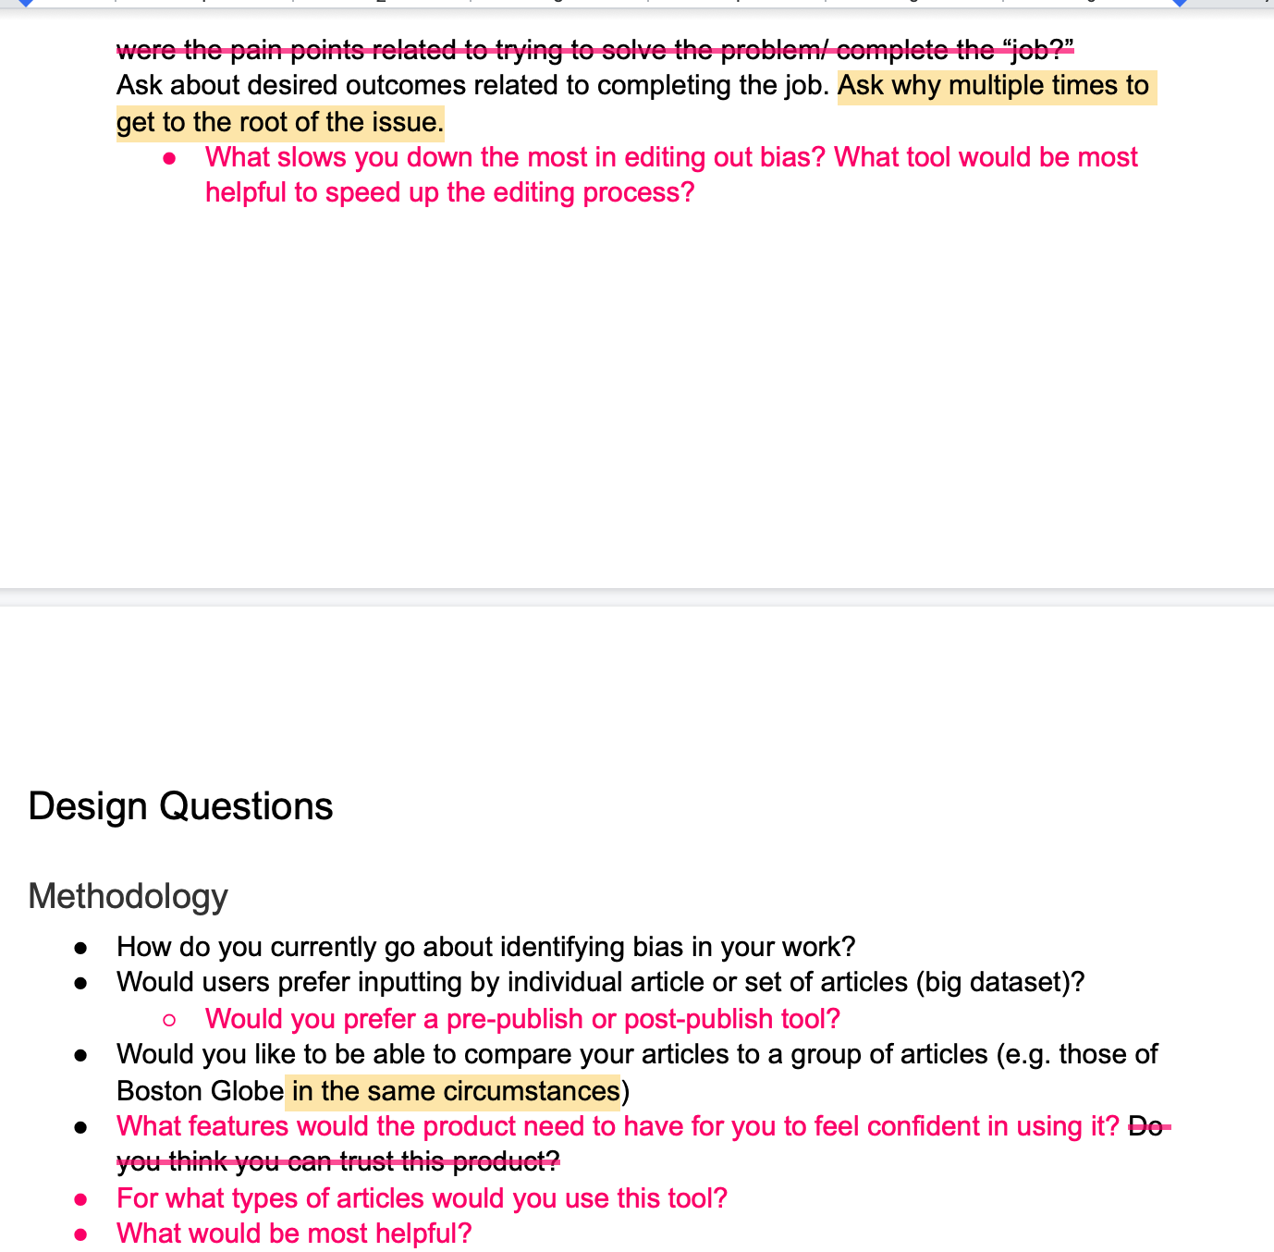
UX Progress——Interview Script

Slide 25
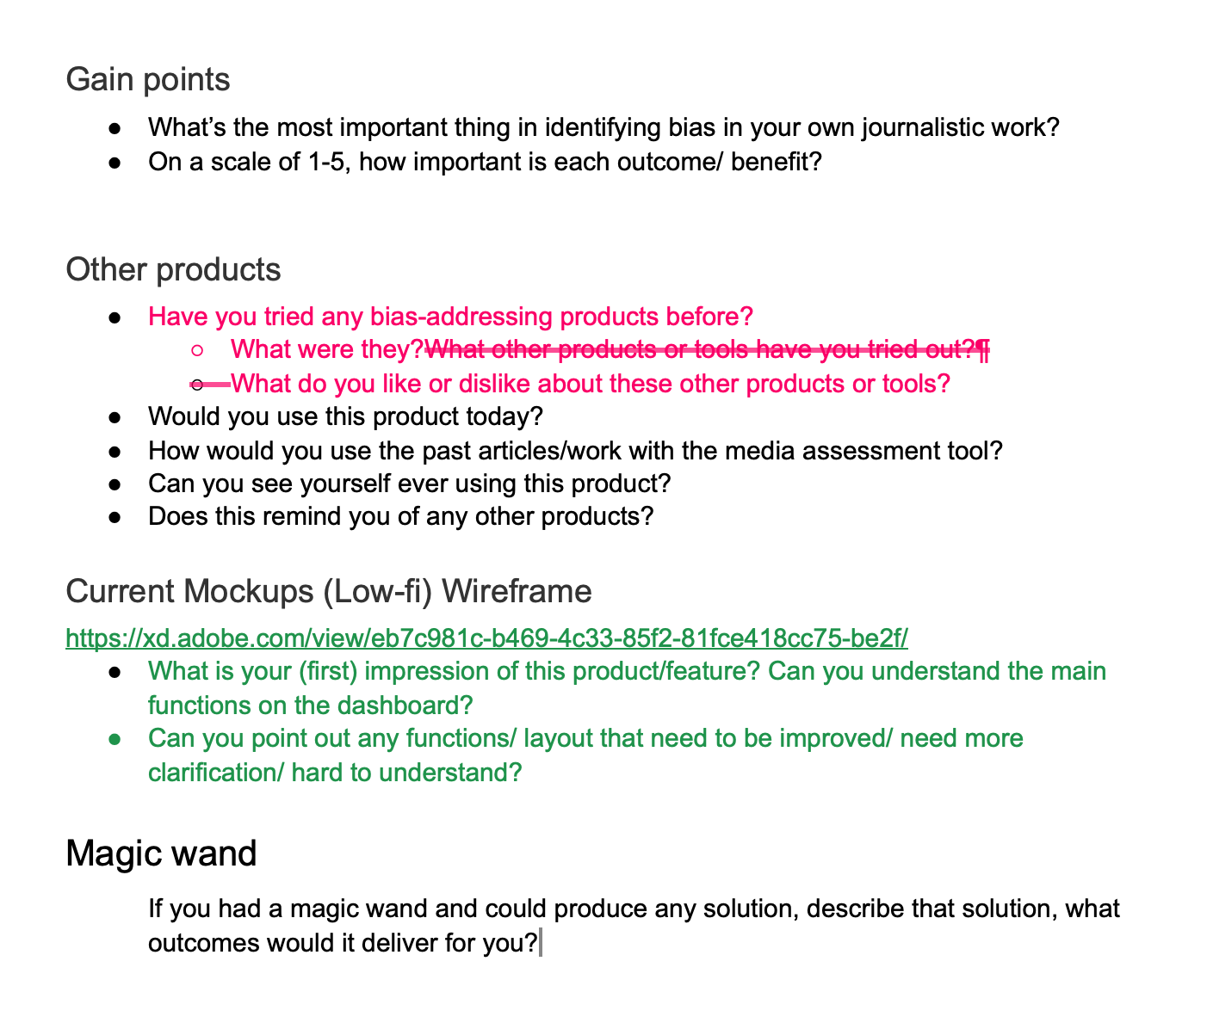
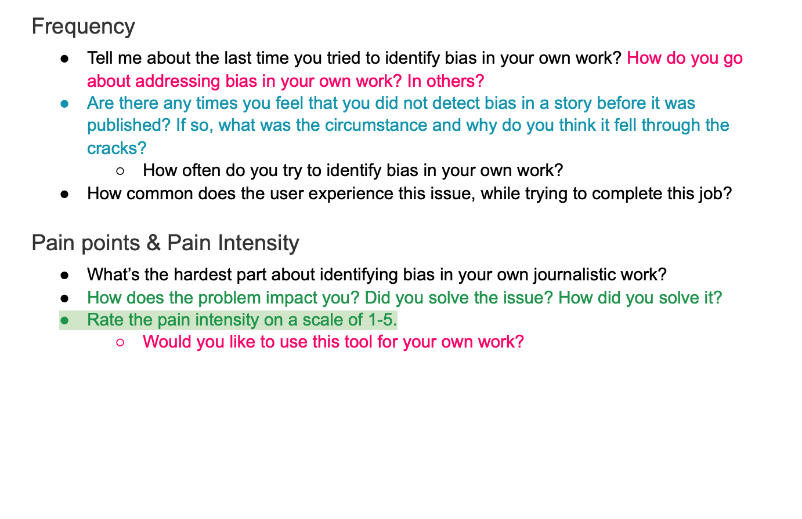
UX Progress——Interview Script

Slide 26
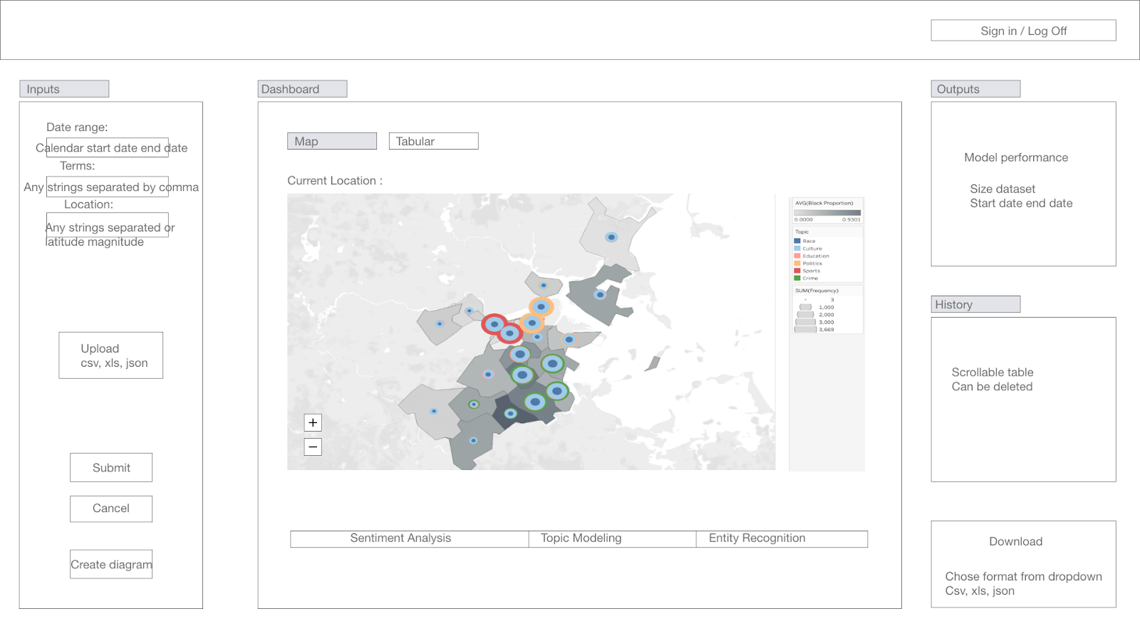
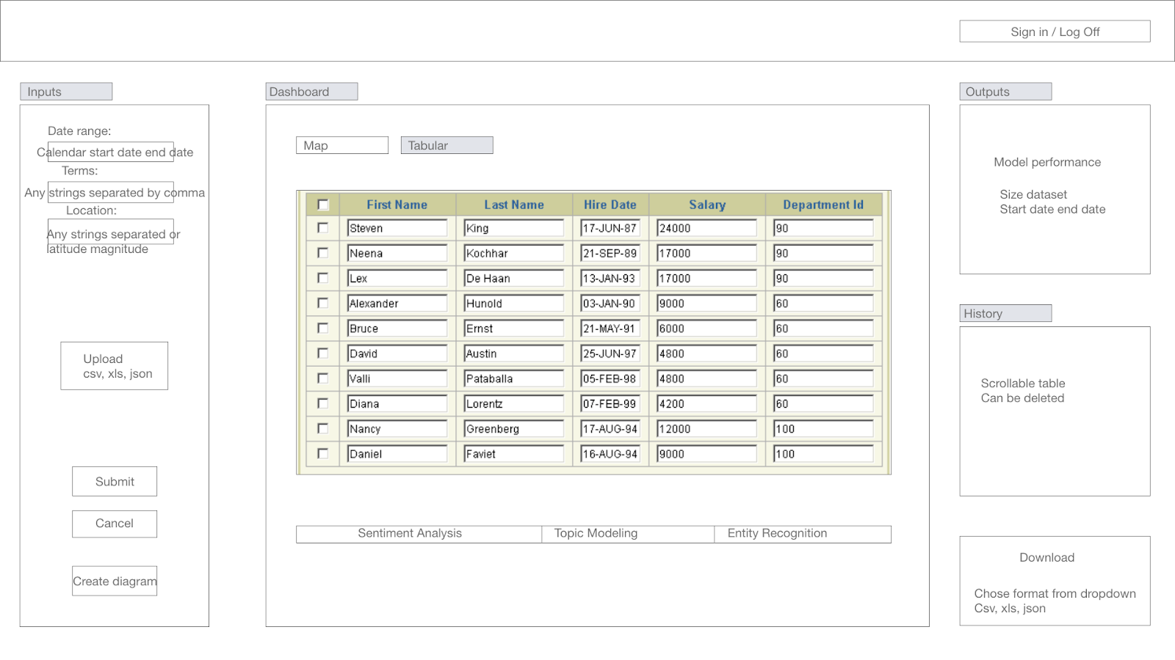
UX Progress——Lo-fi Wireframes for Dashboard

Slide 27
UX Next Step
Finalize the User interview script
Design a basic layout (lo-fi frame) of the real-time editors tool for interview use
Conduct user interview
Research and Create a moodboard of the ux
May start working on the wireframe after user interview (depend on time)

